Slide 1
ETMerholz
The
German
Healthcare
System
by
Dr. med. Erich Theo Merholz, AEMH/VLK
Vice President AEMH
Medical COO &
Head of the Dept. of Maxillo-Facial Plastic Surgery
St. Lukas Hospital
DE-42697 Solingen / Germany

Slide 2
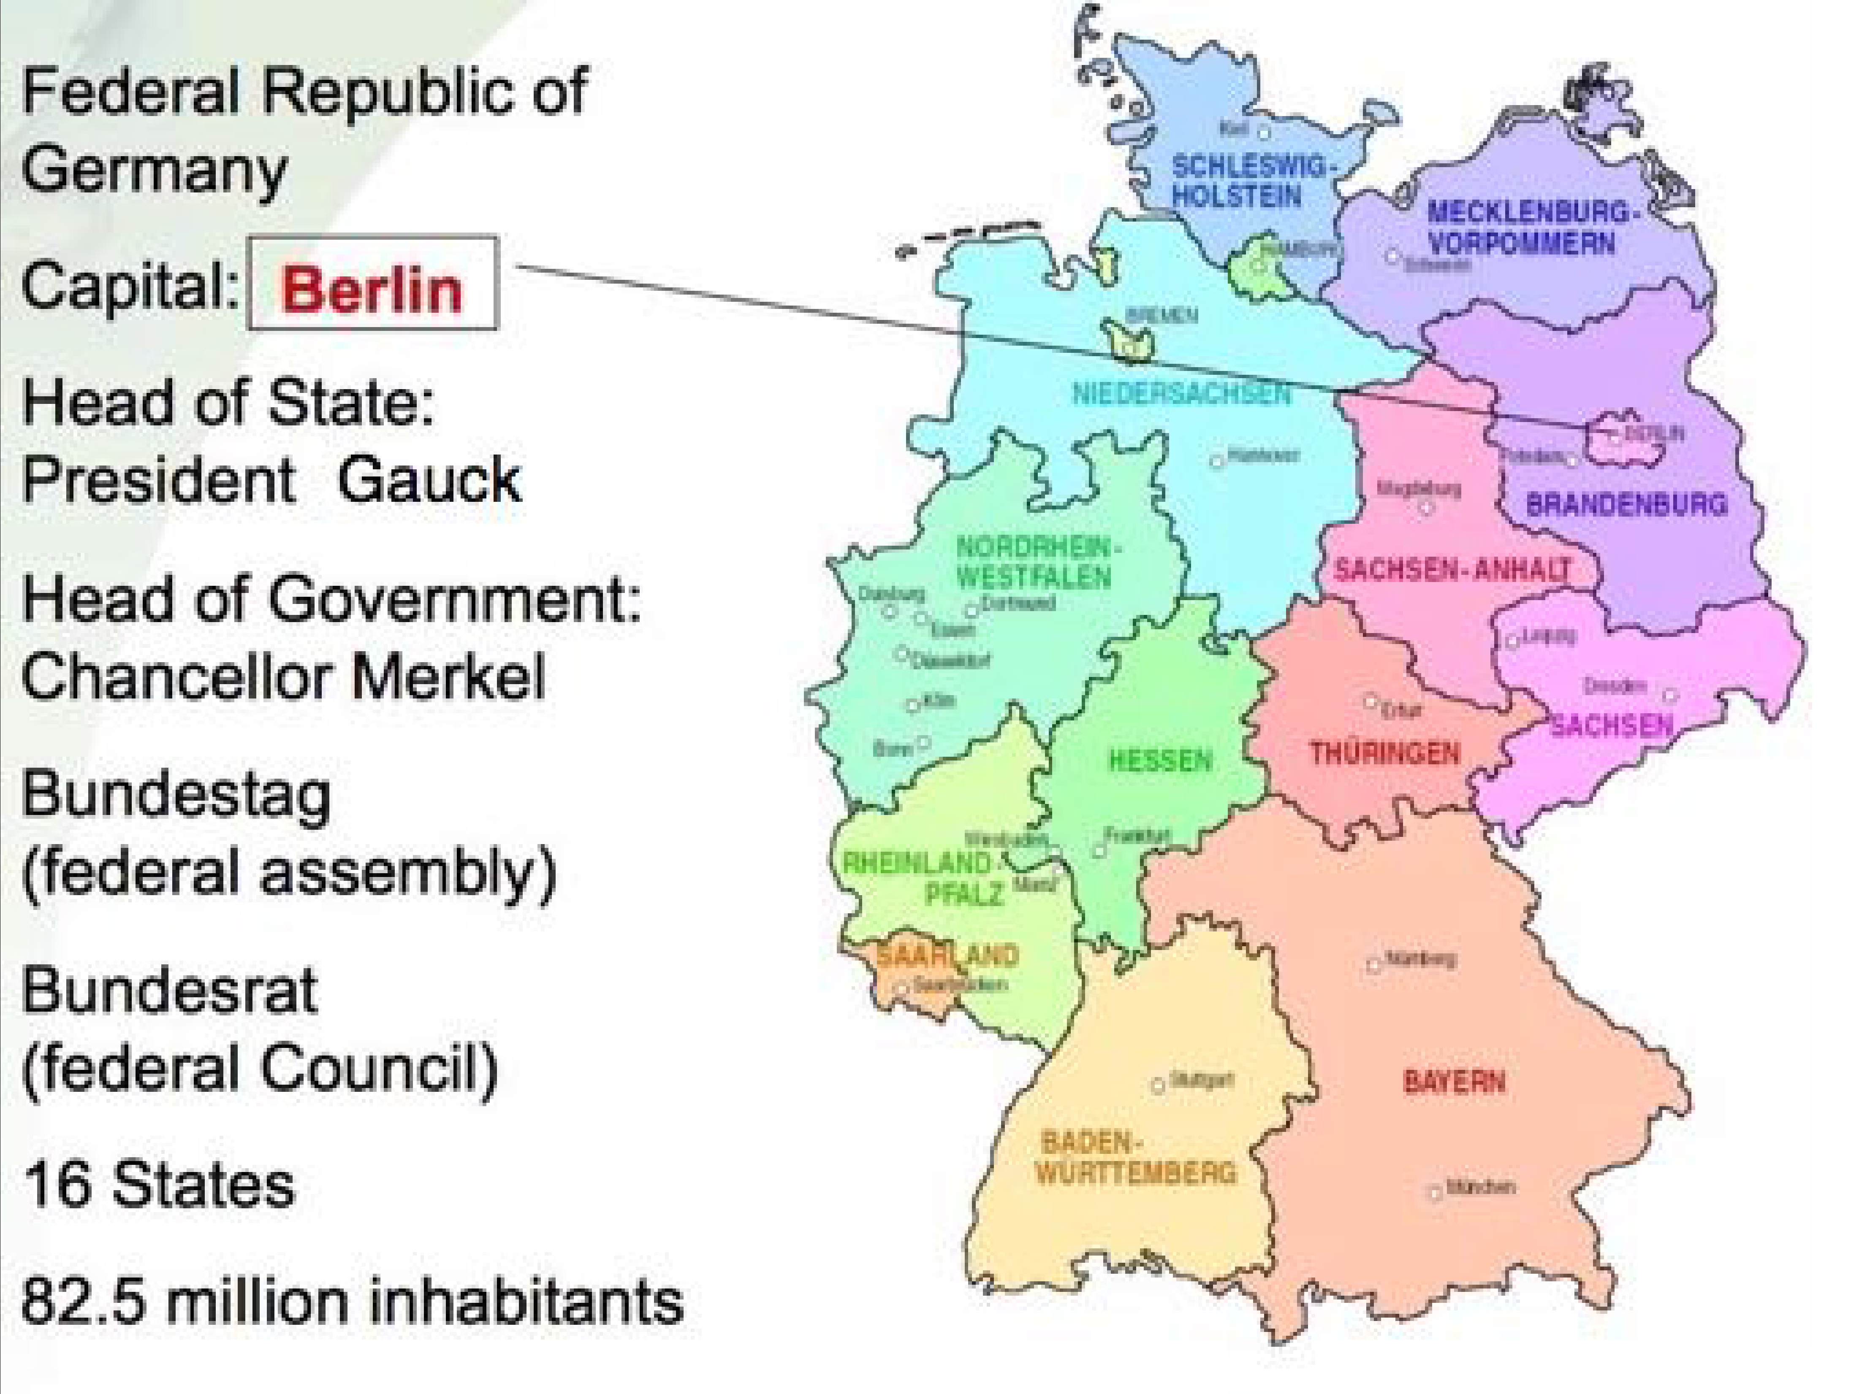
ETMerholz

Slide 3
ETMerholz
German Health Care System
Overview
employs approximately 5 million people (2015)
one out of eight people work within the health care system
biggest branch in German economy with an above average growth
one of the most capable health care systems world-wide
majority of patients are pleased with medical care
patients appreciate short waiting times, free choice of medical practitioners,
close-to-home 24h- & 7d/week medical care and high standards of quality
4.1 practicing physicians per 1000 inhabitants in 2015 (OECD 2017)
CAN 2.4 /
13.3 nurses
CAN 9.9 /
AUS 3.5 / CH 4.2 / AT 5.1
per 1000 inhabitants in 2015 (OECD 2017) AUS 11.5 / CH 17.9 / AT 8.1
9215 graduates from medical schools in 2016

Slide 4
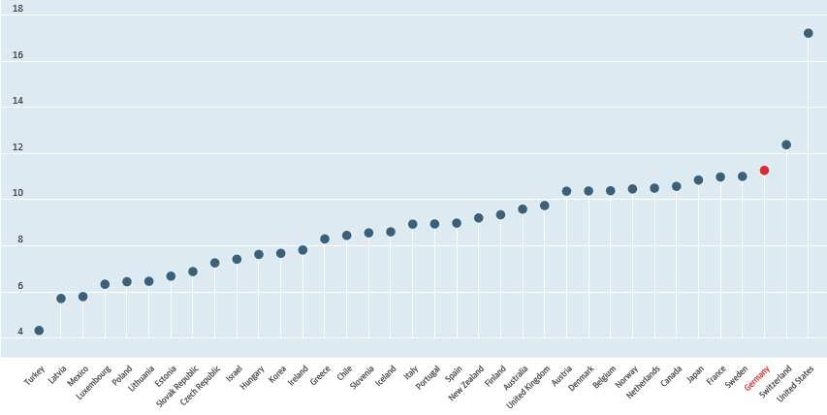
ETMerholz
Total Expenditures - GDP
Total Health Care Spending as % of GDP, 2016 (Source: OECD 2018)

Slide 5
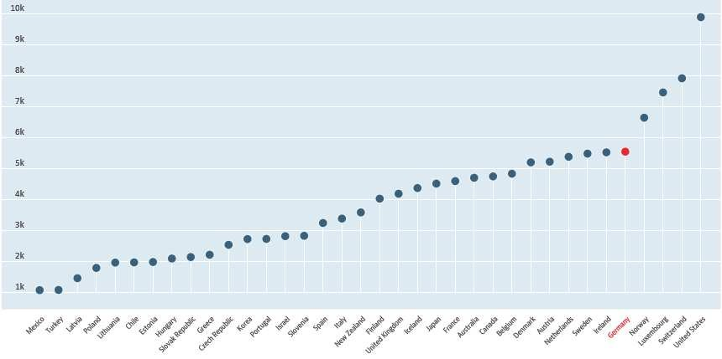
ETMerholz
Total Health Care Spending/capita, 2016 (US-$)
Source: OECD 2018

Slide 6
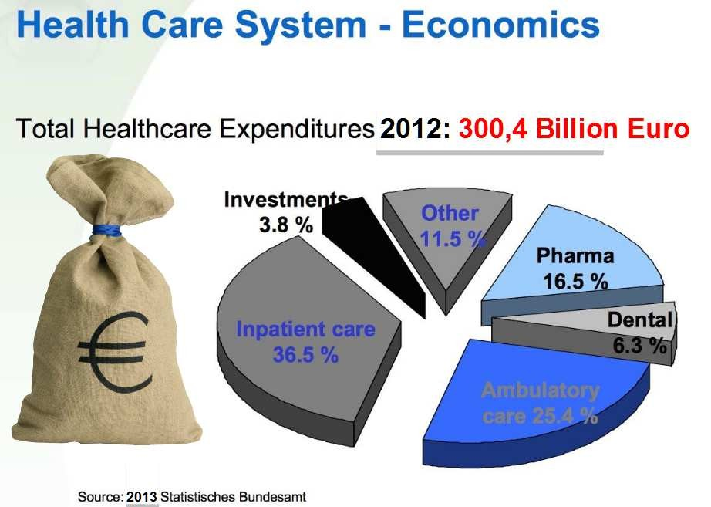
ETMerholz

Slide 7
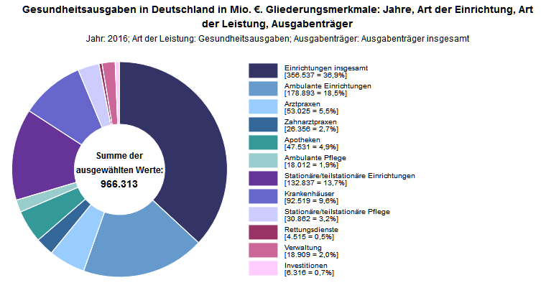
ETMerholz
Total
Health Expenditures
2016
€
356,54
Billion
Source: German Federal Statistical Office (DESTATIS) 2018

Slide 8
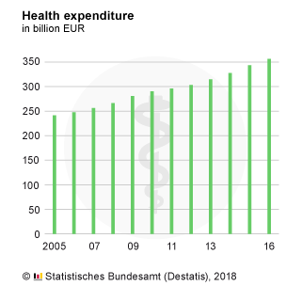
ETMerholz
Total
Expenditures
2005-2016
Nominal Total Expenditures

Slide 9
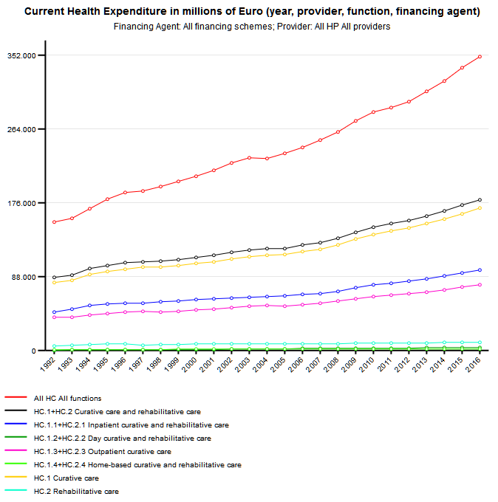
ETMerholz
Total
Expenditures
1992-2016
All
Health
Providers:
Nominal
Total
Expenditures
Source: DESTATIS 2018

Slide 10
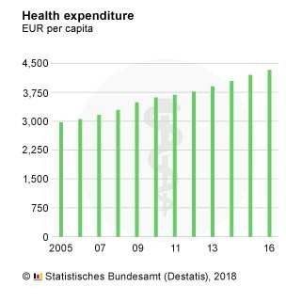
ETMerholz
Total
Expenditures
2005-2016
Expenditures per Capita

Slide 11
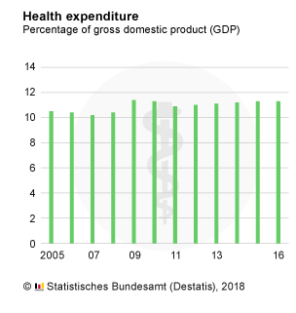
ETMerholz
Total
Expenditures
2005-2016
Expenditures as % of GDP

Slide 12
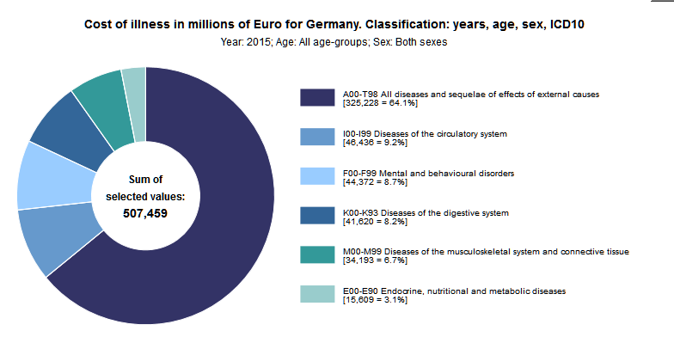
ETMerholz
Costs
of
Illness
2015
€
343,51
Billion
Source: German Federal Statistical Office (DESTATIS) 2017

Slide 13
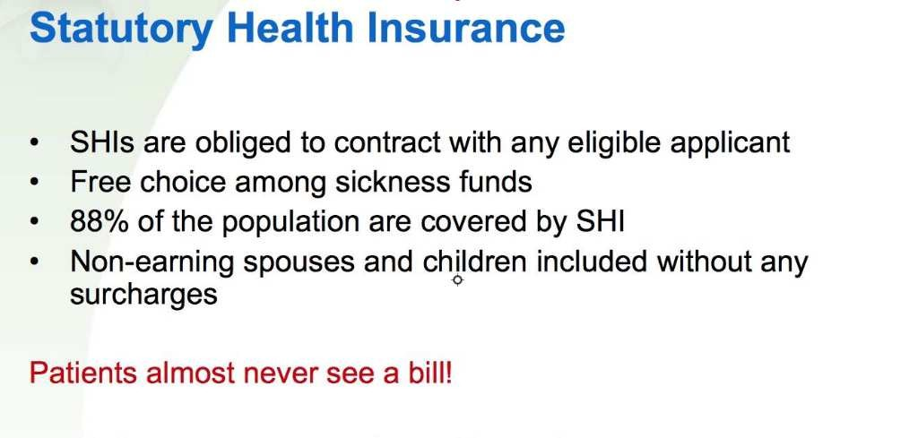
ETMerholz
German
Health
Insurance

Slide 14
ETMerholz
German
Health
Insurance
Statutory Health Insurance (SHI)
SHI membership is mandatory for employees whose gross
annual income does not exceed
€ 59,400.-
in 2018.
SHI premiums are not dependent on risk and are proportional
to the gross income up to € 4.425,-
per monthin 2018.
Contribution rate is 14,6 -15,5 % of monthly gross income
(fixed by law).
Contributions are being shared between SHI-insured employees and their employers (≈ 53% and ≈ 47%)
and cover ≈ 60 % of total health expenditures!
10% of DE-population (self-employed & high-income employees) is privately insured.

Slide 15
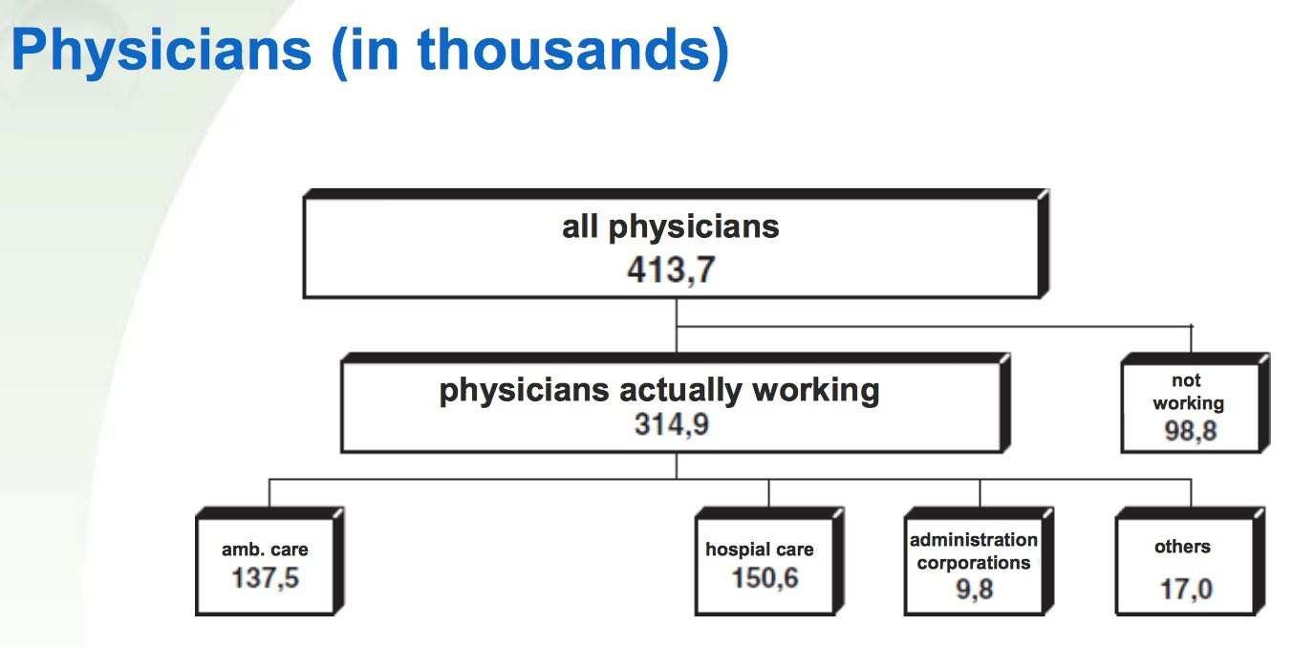
ETMerholz
Physicians in Germany
in
2007
Source: German Federal Chamber of Physicians
2008

Slide 16
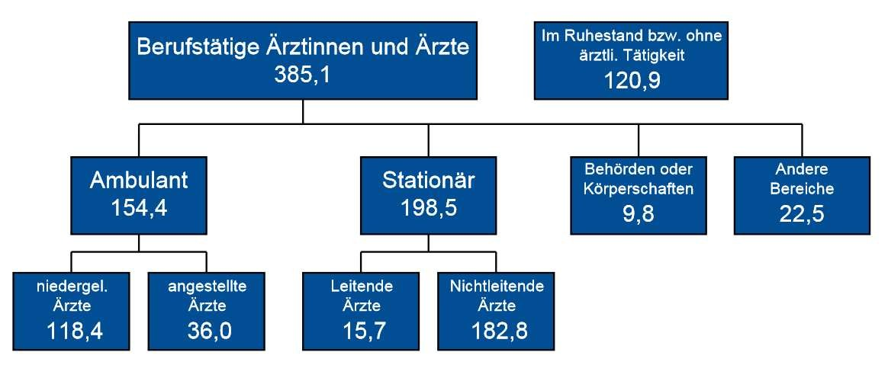
ETMerholz
Physicians in Germany
in
2017
Source: German Federal Chamber of Physicians
2018

Slide 17

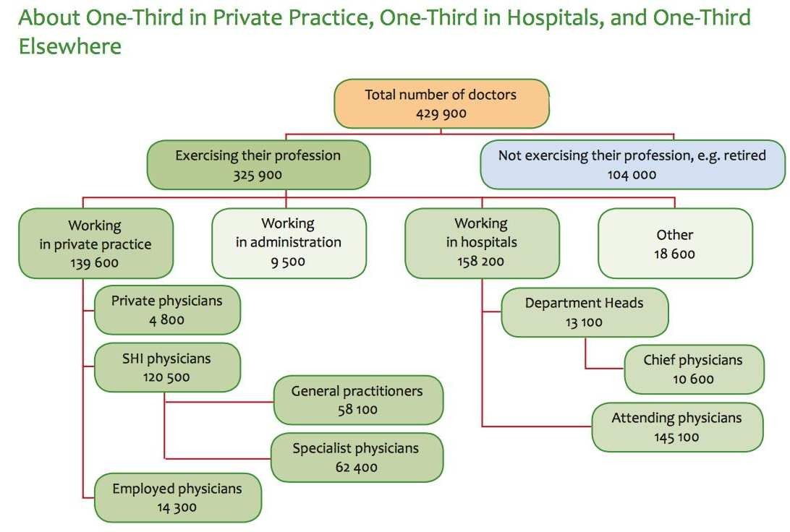
ETMerholz
Distribution of Physicians
in 2009

Slide 18
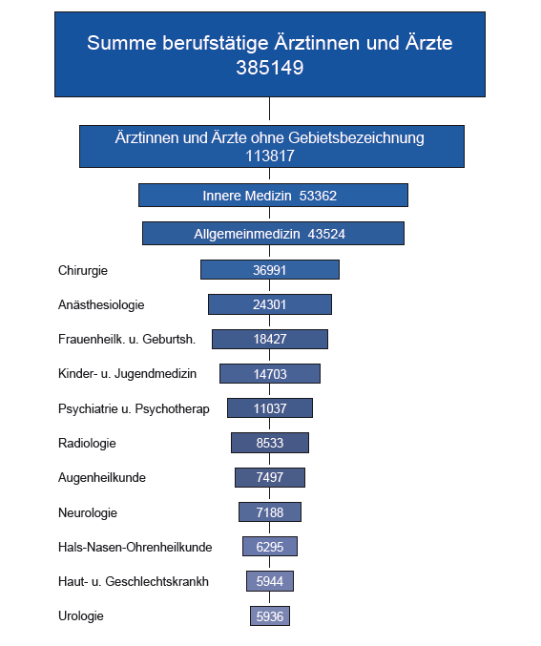
ETMerholz
Distribution
in
of Physicians
2017
Source: German Federal Chamber of Physicians
2018

Slide 19
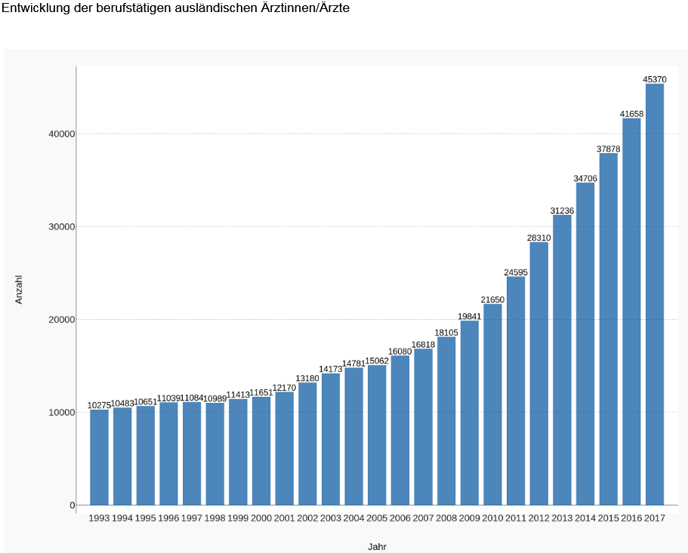
ETMerholz
Non-German
Physicians
in
Germany
Source: German Federal Chamber of Physicians 2018

Slide 20
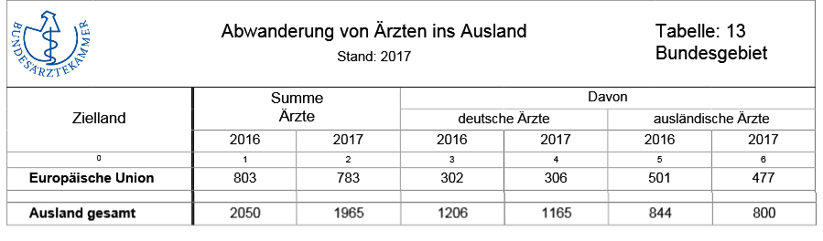
ETMerholz
Physicians
leaving
Germany
Source: German Federal Chamber of Physicians 2018

Slide 21
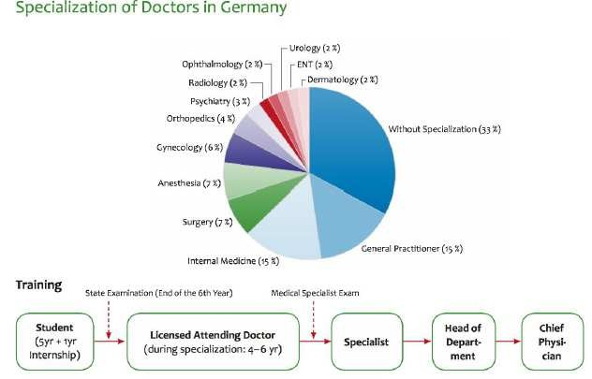
ETMerholz
Medical Specialists

Slide 22
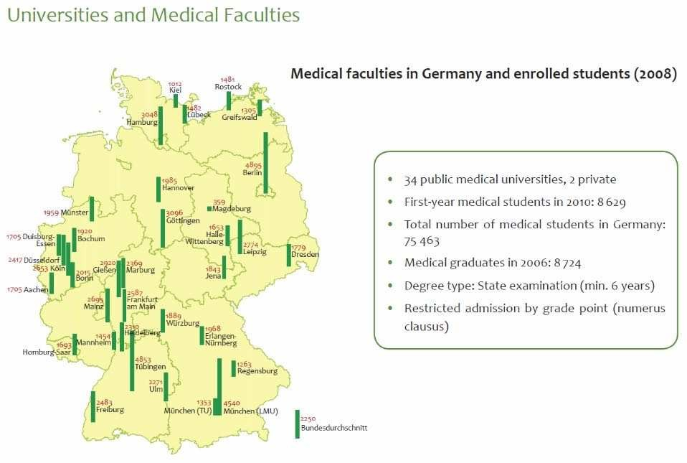
ETMerholz
German Medical Faculties
Medical Graduates (Eurostat2017)
2007
2008
2009
2010
2011
2012
2013
2014
2015
Germany
9.574
9.857
10.069
9.894
9.572
9.587
9.801
9.599
9.215

Slide 23
ETMerholz
Salary of Doctors in Germany
Specific collective agreements with different hospital
operators by Marburger Bund
Physicians earn between
€ 5,658 (sixth year) Specialists earn between
€ 4,402 (first year) and
€ 5,810 (first year) and
onwards)
€ 7,462
(from 13th year
On-call services and overtime paid extra

Slide 24
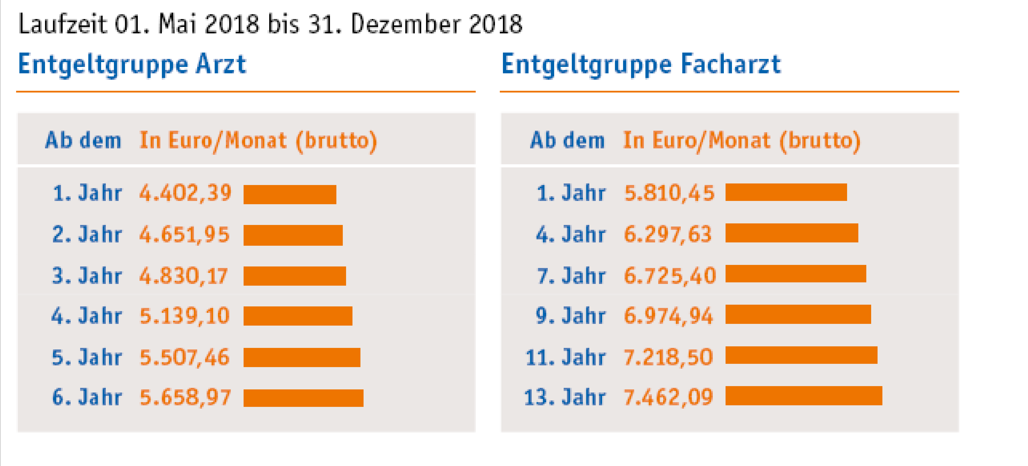
ETMerholz
Salary Scale of Hospital Doctors,
Residents and Specialists

Slide 25
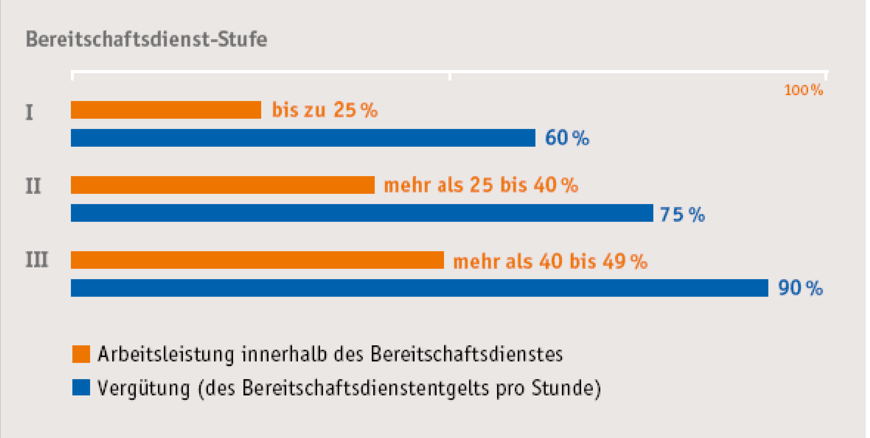
ETMerholz
On – Call Remuneration in Hospitals

Slide 26
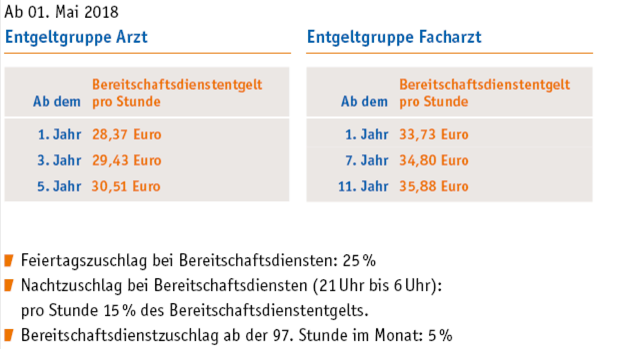
ETMerholz
On – Call Remuneration in Hospitals

Slide 27
ETMerholz
On-Call Remuneration for Standby outside
the Hospital
12.5 % of the overtime pay per hour on
call as basic pay;
At least one hour pay for any call under
e.g. telephone call from the hospital;
Plus any additional hour of work;
Fractions are counted as full hours
Maximum 12 (15) days per month
standby
60
min.

Slide 28
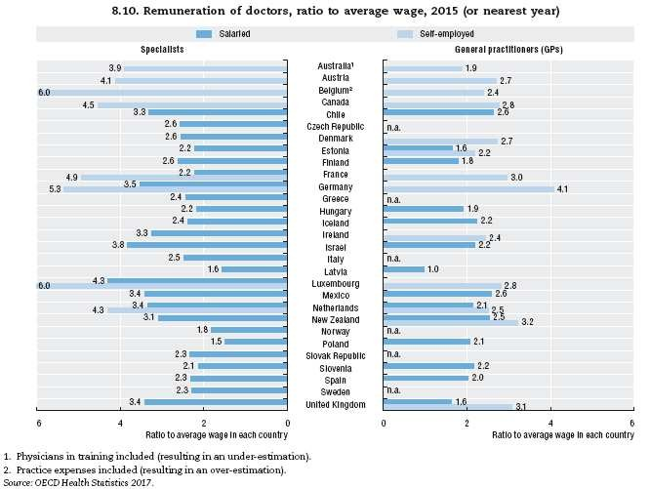
ETMerholz
Physicians’ Income

Slide 29
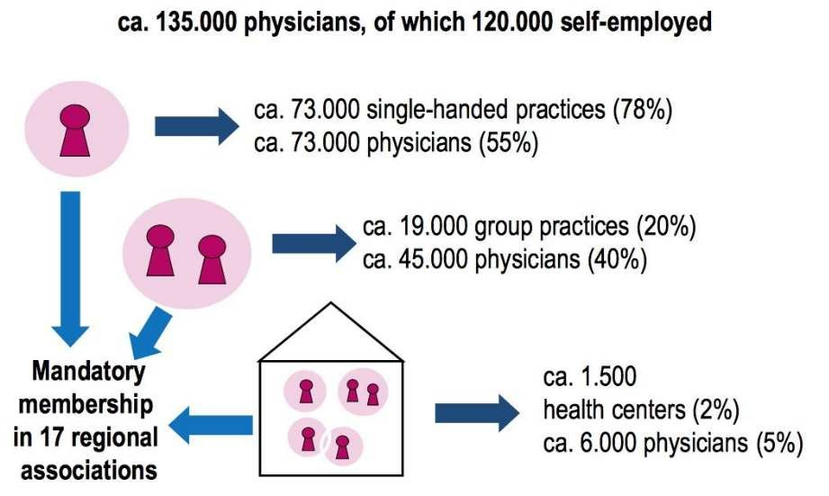
ETMerholz
Private Practice - Ambulatory Care Sector

Slide 30
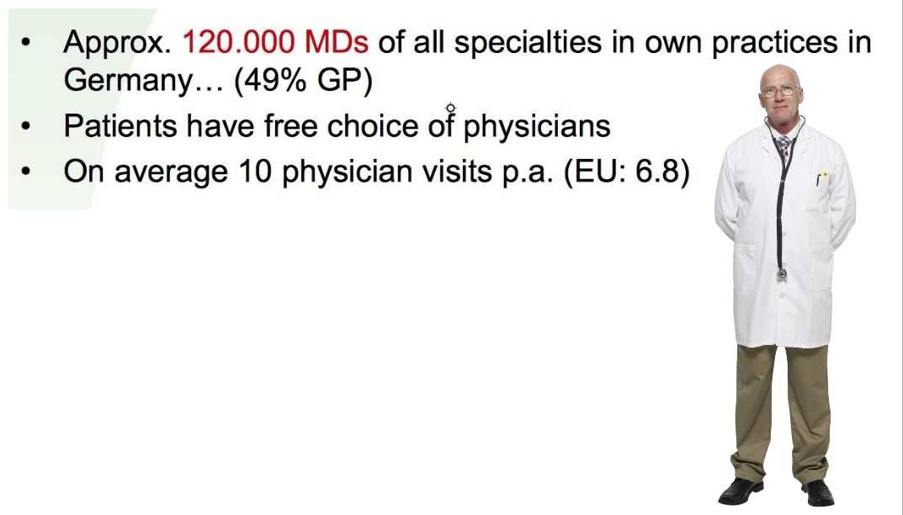
ETMerholz
The Ambulatory Care Sector

Slide 31
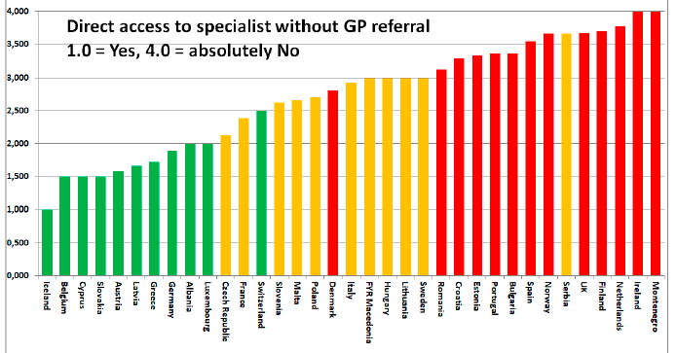
ETMerholz
Free
Choice
of
Physicians
Source: EHCI 2017

Slide 32
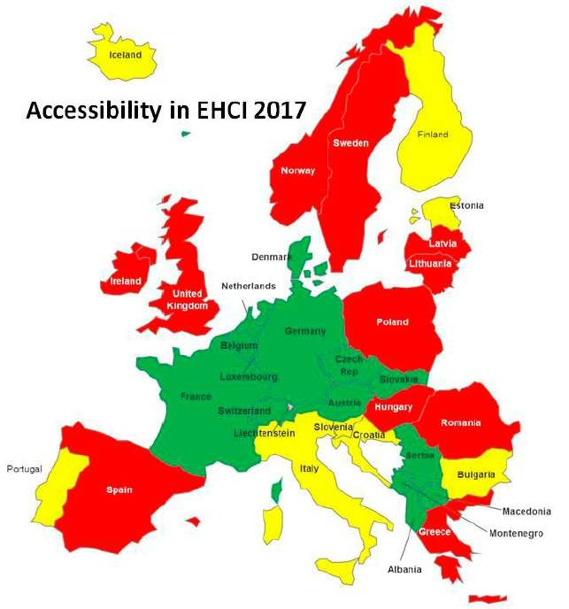
ETMerholz
Waiting Time

Slide 33
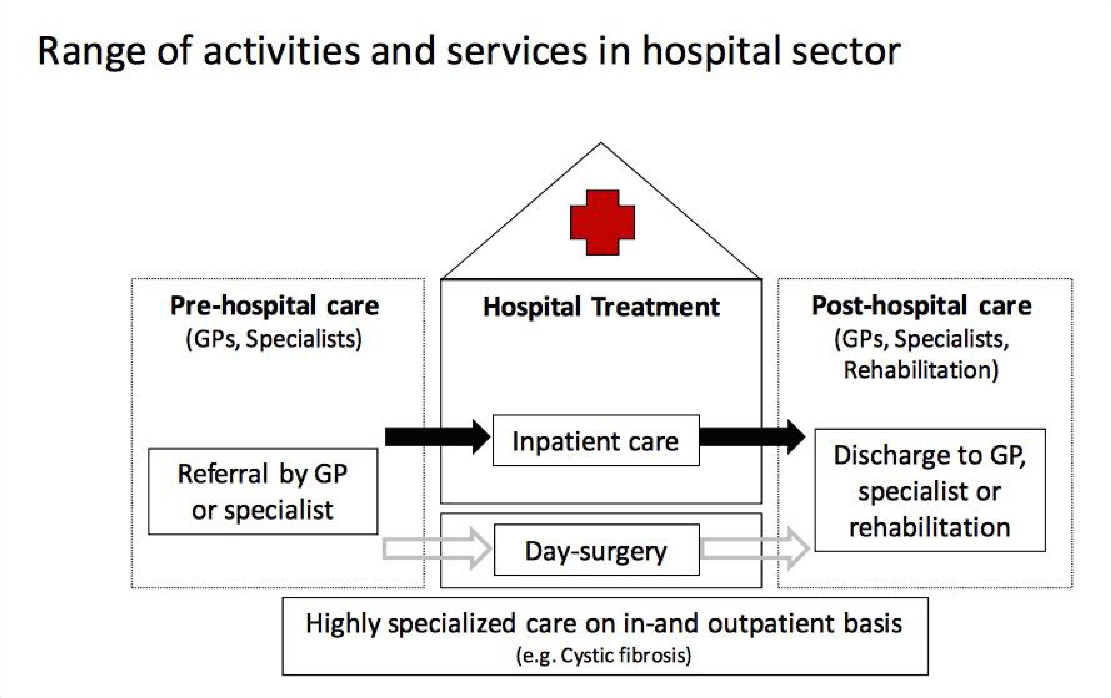
ETMerholz
Hospital Sector in Germany

Slide 34
ETMerholz
Income of Senior Hospital Physicians
Heads of Departments – Income per year
Basic pay -
€ 129,000
average
Variable pay - € 127,000
average
Wide range from € 80,000 onwards
Senior hospital doctors – Income per year
Range from € 70,000 to € 200,000

Slide 35
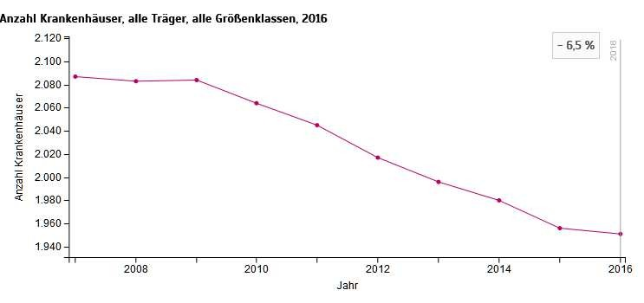
ETMerholz
Inpatient
Care
1951
Hospitals
(2016)
20.064 million patients
in 2016;
average length of stay
in hospital = 7.3 d
in 2016;
Source: DESTATIS 2017

Slide 36
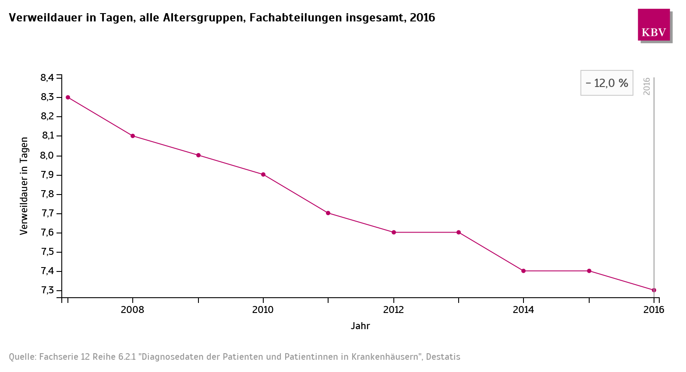
ETMerholz
Average length of stay in hospital 2007-2016

Slide 37
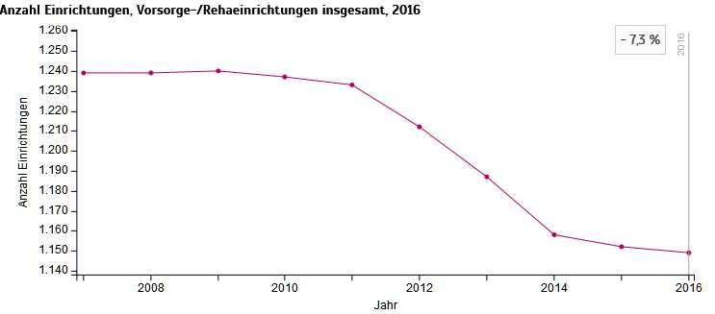
ETMerholz
1149
Rehabilitation
facilities
in
2016
1.98
million patients in 2016;
average length of stay :
Source: DESTATIS 2017
25.3 d in 2016;

Slide 38
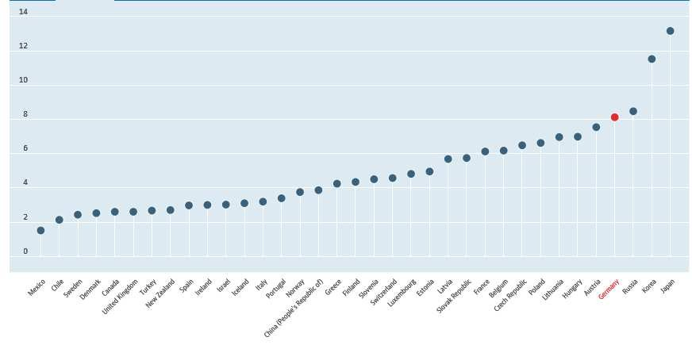
ETMerholz
Hospital Beds per 1000 Inhabitants (2015)
Source: OECD 2017

Slide 39
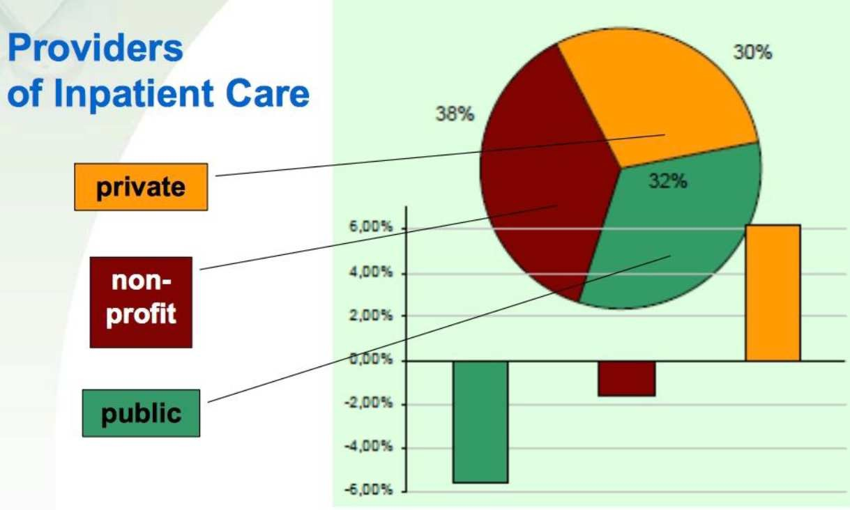
ETMerholz

Slide 40
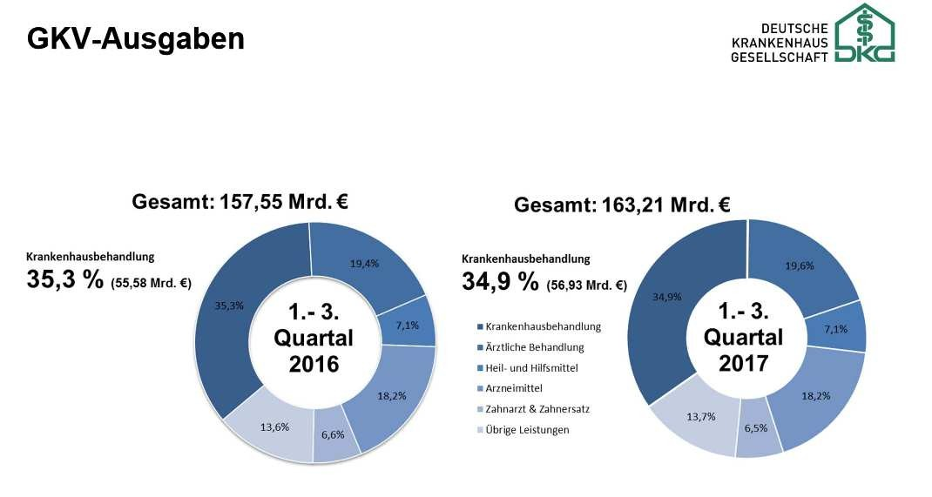
ETMerholz
Total Expenditures of Statutory Health Insurance System
Percentage of Hospital Costs:
2016-I-III = 35,3 %
2017-I-III = 34,9 %

Slide 41
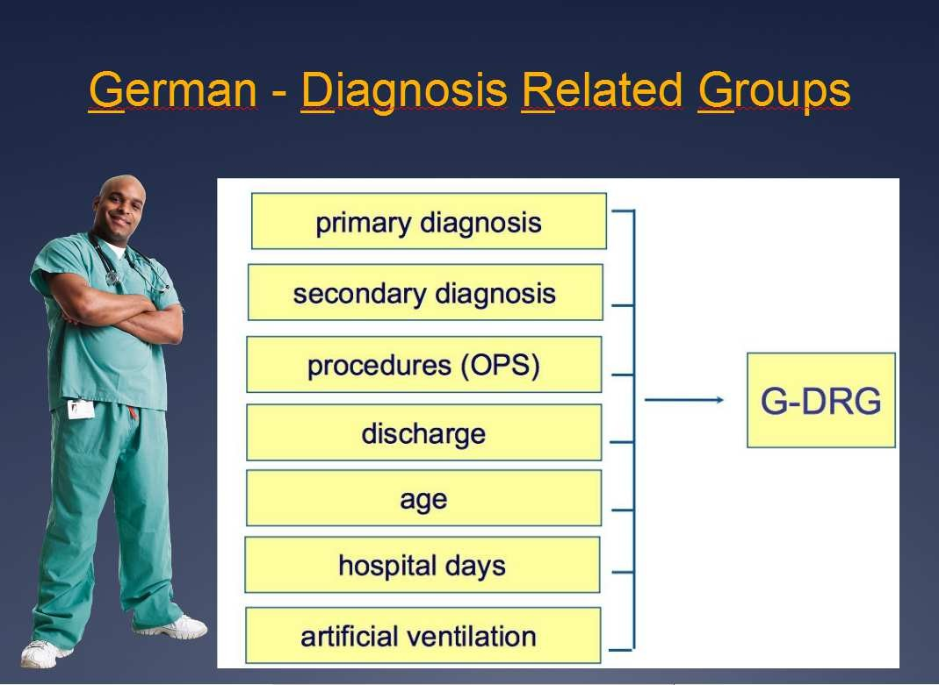
ETMerholz

Slide 42
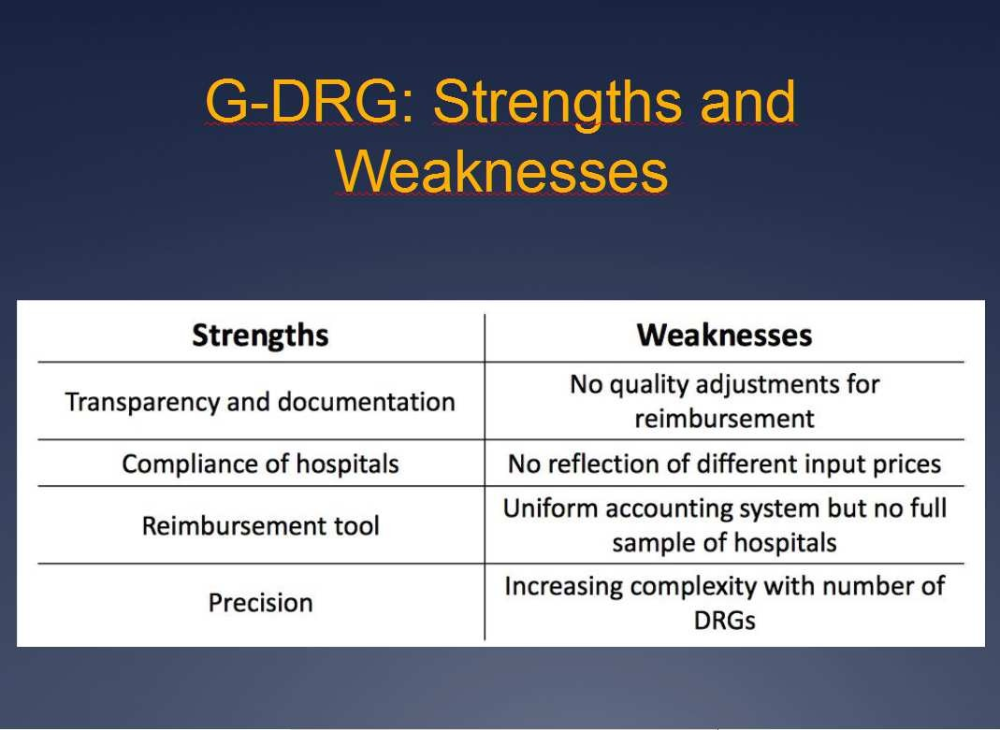
ETMerholz

Slide 43
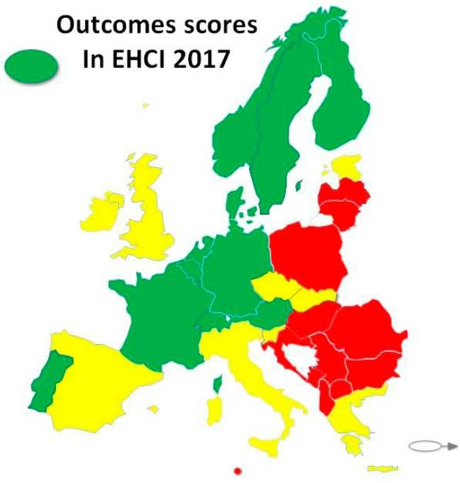
ETMerholz
EHCI Outcomes Scores 2017

Slide 44
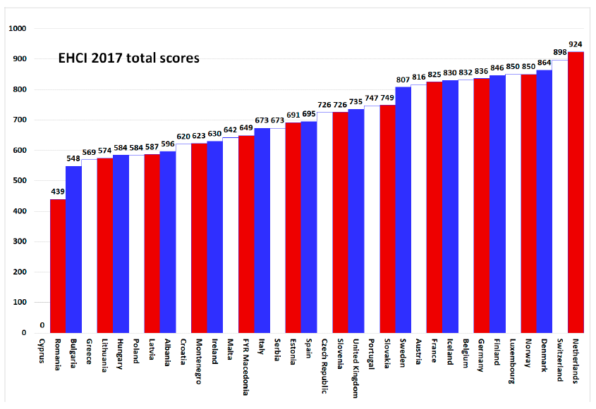
ETMerholz

Slide 45
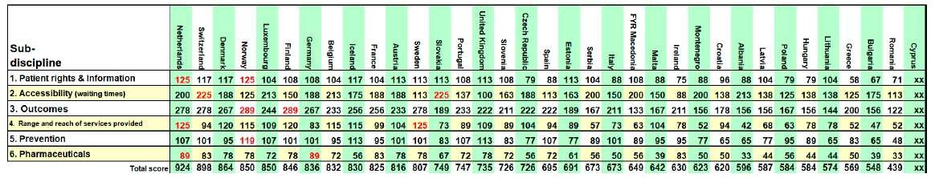
ETMerholz
EHCI Outcomes Scores 2017 - Details

Slide 46
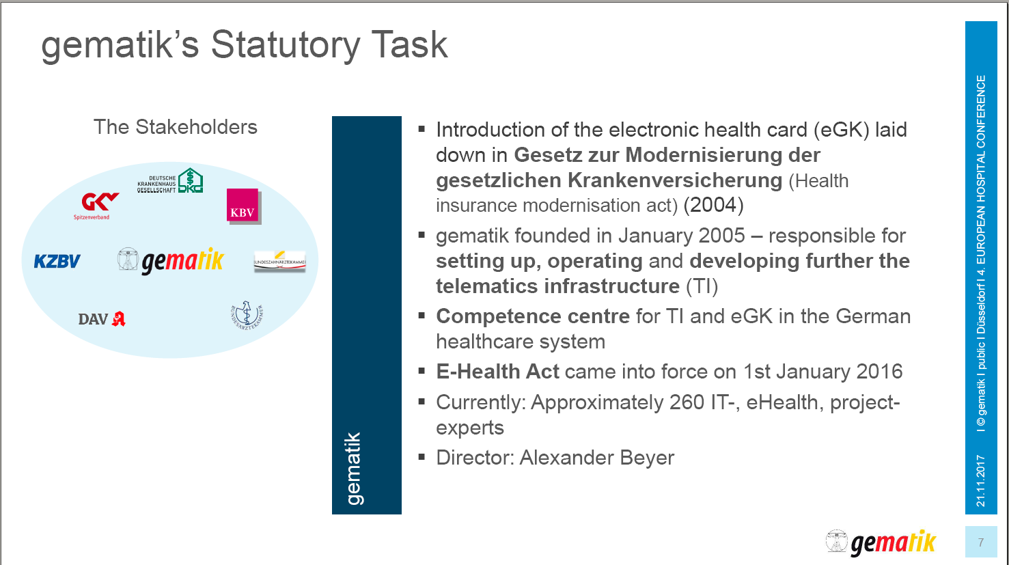
ETMerholz
Implementation of eHealth in Germany

Slide 47
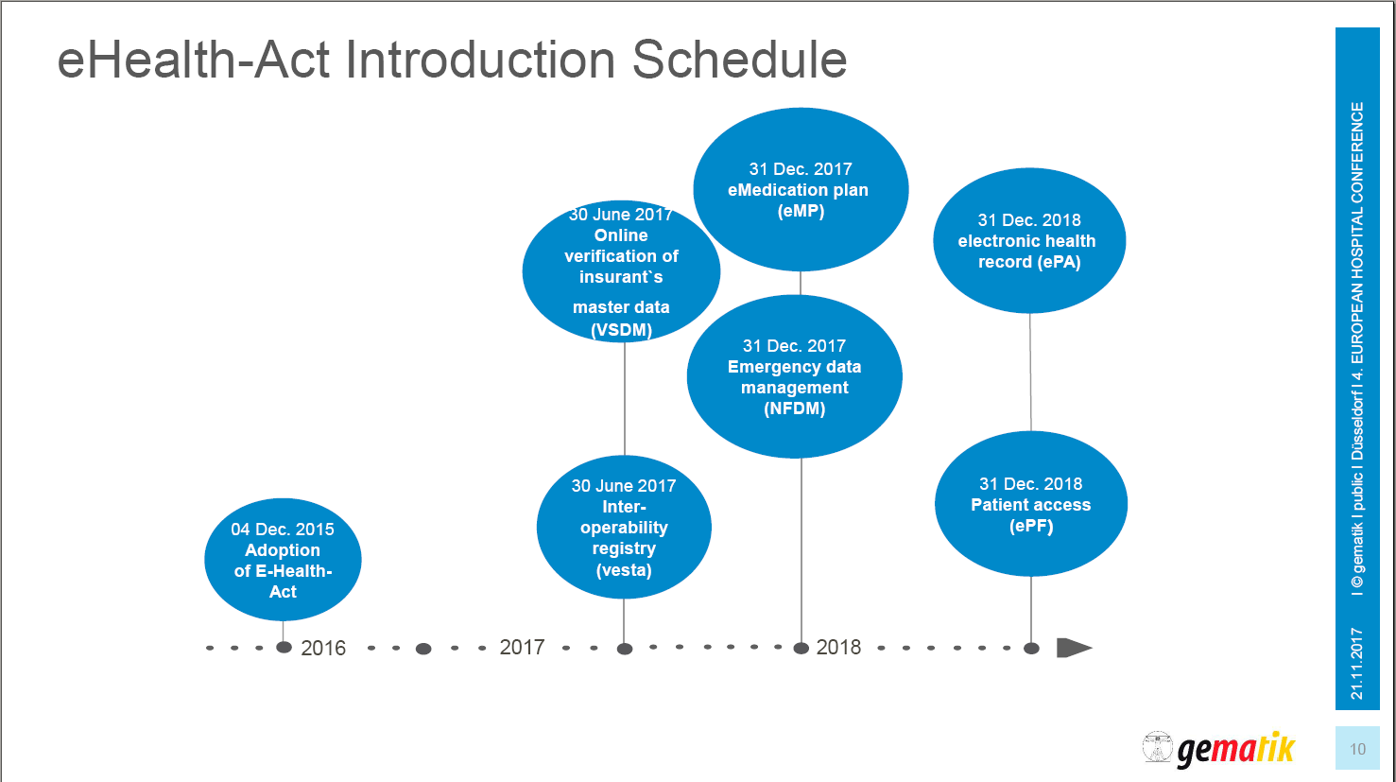
ETMerholz

Slide 48
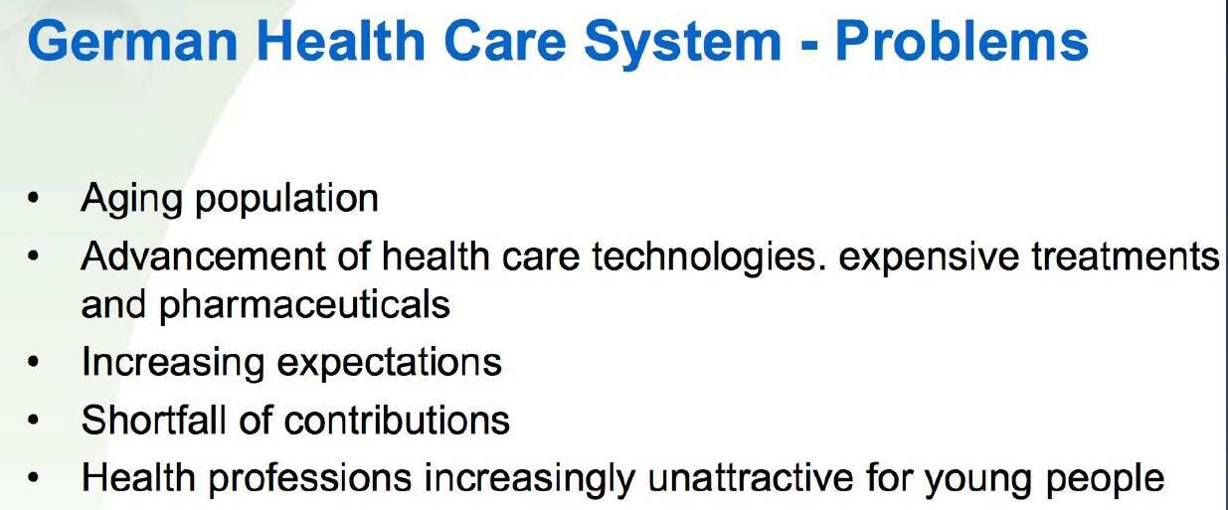
ETMerholz

Slide 49

ETMerholz

