Slide 1
Italian healthcare system - making a point -
Alessandra Spedicato MD

Slide 2
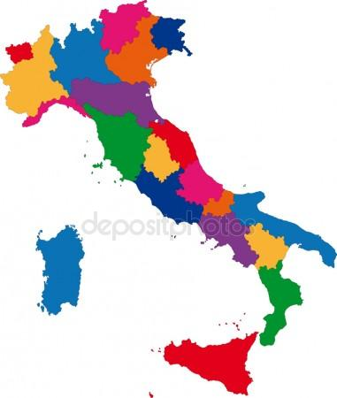



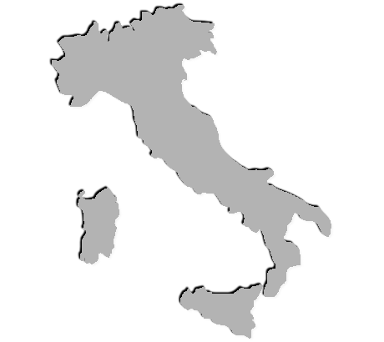

General country information
464000 births
60494000 inhabitants
647000 deaths
337000 immigrants +12%
153000 emigrants -2,6%
Fertility rate 1,34% median age 31,8 years
Life expectancy at birth: 84,9 years for women and 80,6 years for men
Population age structure:
22,6% > 65 years
64,1% between15 and 64 years MEDIAN AGE 45 years
13,4% <15 years
COMMENTS: adequate campaigns on health promotions, health prevention policies and the ability to manage patients with comorbidities

Slide 3
Medical education pathway
Medical degree : 9100 available seats. 89,8% of them complete the educational path in 6 years
Qualification: 4-7 months to get the licence
PGT courses: 6600 + 1000 contracts. In 2017, 15000
participants.
PGT has variable lenght, from 4 to 6 years
On average, from 10 to 13 years
COMMENTS: - to decrease number of enrollments to medical degree courses
- to increase PGT contracts

Slide 4
Medical information patient access data
Hospital activities:
In 2016
8240942 hospital discharges
195000 hospital beds
3,7 beds/1000 ab 0,7 beds for long-term care
Emergency Department:
24 millions of visits 1% red tags
18% yellow tags
66% green tags
15% white tags
Waiting times:
Green tags from 70 to 300 minutes
Yellow tags from 30 to 120 minutes
35% of emergency departments offer web information
COMMENTS: - too high percentual of beds full * 99% to 115%
- GP inside casualties to treat white tags

Slide 5

Medical information medical workforce
296000 doctors are in active practice
185650 doctors have one or more PGT title
104000 doctors work in NHS with a permanent contract
MEDIAN AGE IS 53.06 YEARS
12000 doctors work in NHS with temporary contracts
54831 General Practitioners
20000-25000 young doctors are waiting to access to PGT schools
COMMENTS: - in next 5 years, a great number of retirements
- increase of misuse of temporary contracts
- need for educational planning otherwise number of unemployed doctors is going to increase

Slide 6

Medical information financial data
Year 2018
Healthcare sector budget: about 113 billion euros
6.5% of italian GDP
Year 2020, 6.3% of GDP
COMMENTS: italian government makes healthcare fund strictly connected to GDP. This fact, as well as staff shortages and lack of planning, proves there isn’t any interest to invest money in this sector

Slide 7
Medical information EWTD enforcement
EWTD was transposed in Italy in 2014
Not fully implemented yet:
Daily rest
48 hours weekly workimg time
CME
Days off
Violations during PGT
Attempting to derogate
COMMENTS: - the only solution is new employments and making doctors aware of their rights.
- cultural and mental change

Slide 8


Migrations
2006-2016 4600 doctors left Italy
Main destinations: UK, Switzerland, Israel, France, Germany and Belgium
2006-2016 3262 doctors came in Italy
No certain data regarding countries of origin
COMMENTS: - the educational path, from primary school to PGT training, costs on average 150000 euro…

Slide 9

Hospital Network
Presidi Ospedalieri di base ( Local Hospital Centre), catchment area 80000-150000 inhabitants. It is provided with casualty ward, and the following departments or services: internal medicine, general surgery, orthopedics, anesthesia and ( on call work) radiology, laboratory and blood bank
Presidi Ospedalieri di I livello ( First degree Hospital Centre) catchment area 150000-300000 inhabitants. In addition on the above: Gynecology and Obstetrician services, Pediatrician, cardiology an d cardiology intensive care, Neurology, Oncology, ophthalmology, ENT, urology.
Presidi Ospedalieri di II livello (Second degree Hospital Centre) catchment area 600000-1200000 inhabitants. In addition on the above, it is equipped with the more sophisticated services.

Slide 10
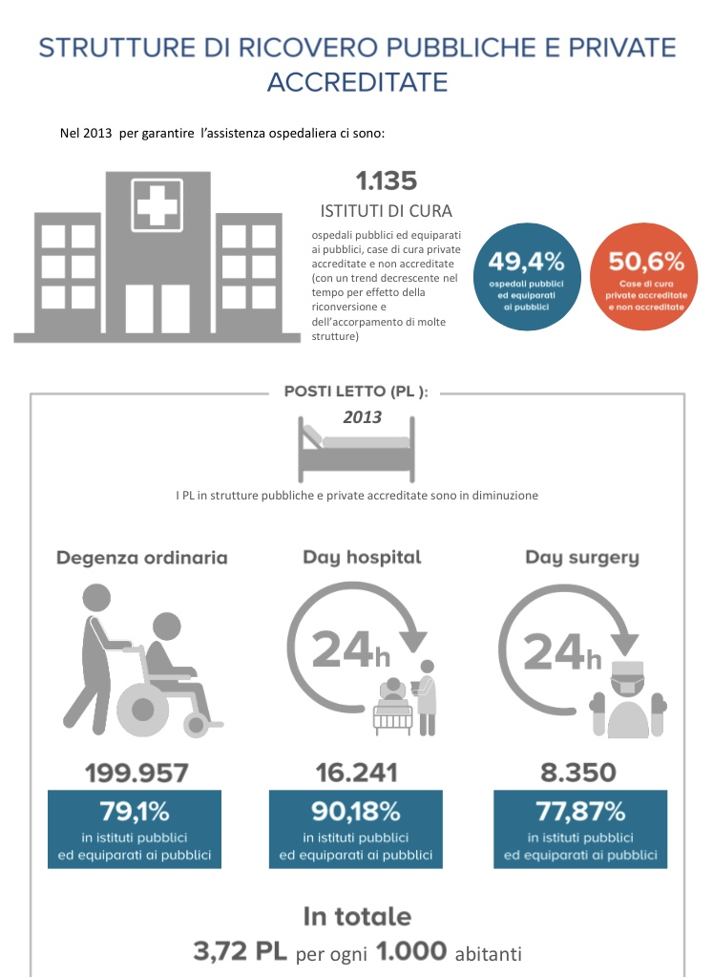
Hospital Network
1100 health institutions
49,43% public funding
50,53% private and public funding
inpatients
COMMENTS: patchy distribution of medical services. An uneven situation causing patients’migration

Slide 11

E-HEALTH
10% of patients scheduling an appointment
78% e-prescriptions
46% individuals using the Internet seeking health information
EHR system in 7 out of 21 Regions
2018 budget Law allocates1,27 billion euros (1,1%)
Some estimations suggest roughly 20 billion (10-15% of healthcare fund) could be saved with those tools
COMMENTS: Service must invest more financial resources for eHealth to allow for more efficiency, maximization of service supply, a reduction of medical errors, an increase in patient safety, and an improvement in chronic disease management. Moreover, it should draft clear policies for safety and privacy.

Slide 12
WAITING LISTS
SURVEY:
4 italian Regions 26 million of inhabitants (44% of italian population)
11 not urgent medical services:
Eye exam,
orthopedic examination
joint x-ray
spirometry
Echocardiography
venous Doppler ultrasound of lower limbs
thyroid ultrasonography
colonoscopy
gastroscopy
electromiography
angiography

Slide 13
WAITING LISTS
Waiting times (days) in Public hospitals, private practice activities in PH, private hospitals with public funds, private hospitals
Eye exam
orthopedic exam
joint x-ray
spirometry
echocardio venous Doppler
thyroid US
colonoscopy
gastroscopy
electromiography
angiography
Only xRay services are provided within 30 days
COMMENTS: - waiting times are symptoms of the continuing cuts in public healthcare.
- Need to analyze good experiences such the one in Emilia Romagna
- Tuscany region proposal

Slide 14
ACCESSIBILITY
2016: new minimum healthcare standards (LEA)
Reduction of inpatient services and day hospital services
Increasing of outpatient services ( cost reduction and higher incomes)
Money saved not reinvested causing a worsening of supply-demand gap
Increased imflow of patients to casualties. A vicious circle.
COMMENTS: 5 millions of Italians geve up a medical treeatment in last year…

Slide 15


OUT OF POCKET PAYMENT
In 2016 37,3 billion of euros
600 euro each, including children
Patients’ contribution and insurance policies or health funds.
Analysis of consumption reveals that those medical expenses are mostly for futile products and services
COMMENTS:

Slide 16
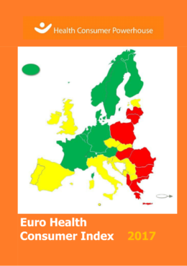
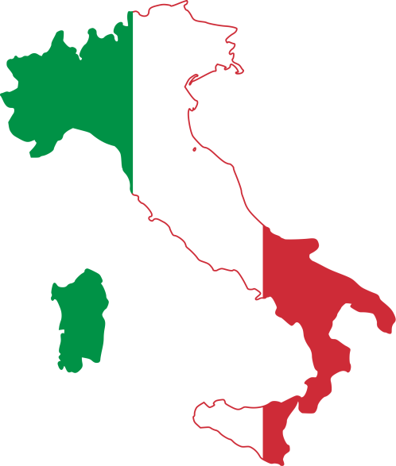
Euro Health Consumer Index’s Comments
20° place, 673 points
EHCI states: “Although in theory the entire healthcare system operates under one central ministry of health, the national Index score of Italy is a mix of Northern Italian and Rome Green scores, and Southern Italian Red scores, resulting in a lot of Yellows.”
NOT FULLY AGREE

Slide 17
Euro Health Consumer Index’s Comments
EHCI states:“In southern Europe, Spain and Italy provide healthcare services where medical excellence can be found in many places. Real excellence in southern European healthcare seems to be a bit too much dependent on the consumers' ability to afford private healthcare as a supplement to public healthcare”
NOT FULLY AGREE
Public institutions assure 95% of hospitalization needs, 60% of outpatient services and 65% of long term assistance
Private services are absent in Emergency Departments and major surgery

Slide 18
Euro Health Consumer Index’s brief Comments
Patient organisations involved in decision making. Great participation and informed consent is highly recommended.
Right to second opinion. I don’agree whit this score. In case of outpatient services, patients can get a second opinion paying a patient’s contribution.
We don’t have any bona fide doctors register
Regarding medical records, they are accessible (not immediately) on a paper version
General practitioner’s activity is quite good
Regarding waiting times, we already discussed above

Slide 19
Euro Health Consumer Index’s brief Comments
30-day case fatality for AMI is decreased. It’s8,6% with a low inter-regional variability.
% of caesarean sections is decreasing: 24,5% for the very first time under Italian thresholds of 25%, despite the fact that there are relevant differences among regions and inside each region, at local level

Slide 20
Euro Health Consumer Index’s brief Comments
Data shows that smokers are about 20% of population over 14 years old
Italian Government has recently promoted an important vaccination campaign,causing problems with public opinion (no vax associations). Result is that we are reaching a good vaccination coverage rate.
Italians use 27,5 DDD/1000 ab/die while EU average is 22,4. DDD is Defined Daily Dose
Rx subsidy. As said above regarding waiting times and out of pocket payment

Slide 21

PROS AND CONS
Happy 40th birthday!!!!!
The system is as sustainable as we want it to be ..
- to adopt prevention policies (a broader perspective that goes beyond direct, indirect and short term costs)
- to improve long term care ( due to age structure society)
- to overcome health sector regional federalism (that cause further costs)
- to increase number of beds (also to prevent infections’ disease that could prolong hospital stay)
- to control private hospital activity (costs are less auditable, workforce happens to be exploited)
- to invest on staff resources ( to optimize fixed costs and the use of medical equipments)
a universal and equal access to high quality healthcare services to all citizens

Slide 22

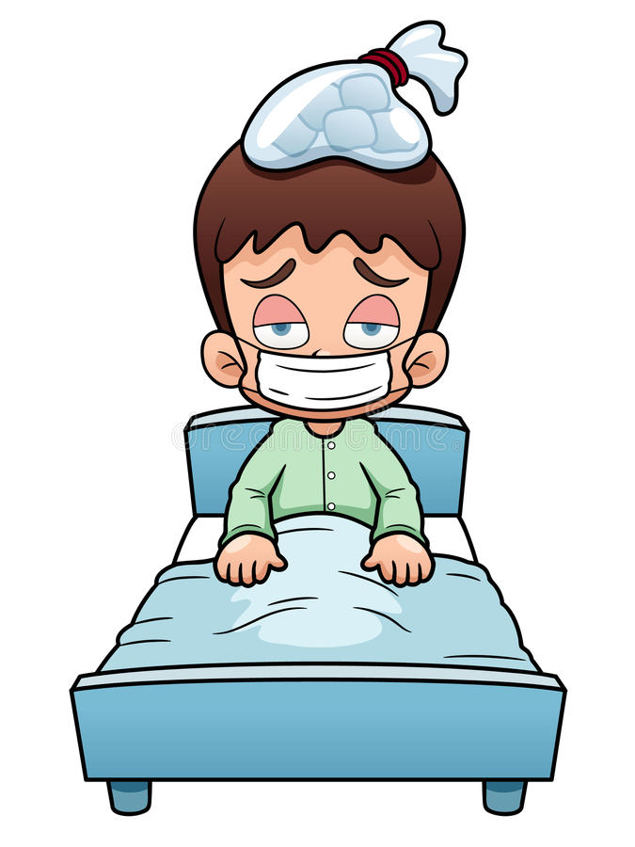
Present situation and plans
Italian government is characterized by a fragile political stability and it’s unknown how long it will last
Italian public healthcare sector

