Slide 2











Vlad TICA
Clinical Leadership
Academy
Conference
Oslo
2019
Professor & Chair, OB/GYN Dept.
University «Ovidius», Constanta, Romania
Psychotherapist
Notes:
Or, sometimes of what we thrive / we dream to be. In the name of an evolution beyond the altars of Medicine.
You, Omar, asked me to witness with you Femininity.
And how better could I have done that than sharing with you

Slide 3
Vlad TICA
Clinical Leadership
Academy
Why
Who
How
Professor & Chair, OB/GYN Dept.
University «Ovidius», Constanta, Romania
Psychotherapist
Notes:
1
1
1
1
Survey of Clinical Leadership - Rainer Riedel, Prof, MD, Director, Institute of Health Economics Outcomes Research, Cologne, Germany
Physicians’ role in the management and leadership of healthcare. A scoping review, Karin Båtelson, MD, AEMH vice-president
Clinical leadership – an integrative holistinc approach in becoming a physician, Anja Tuulonen, Prof, MD, Head of Department, Tays Eye Centre, Tampere University Hospital
Sustainability in leading change: value and innovation, Ioanna Psalti, MD, Director, Dime Ltd, UK
Importance of young doctors in Clinical Leadership, Francisco Ribeiro Mourao, Chairperson, Postgraduate Training Committee, EJD
Structured Training / ETR / UEMS experience, João Greno, MD, UEMS vice-president

Slide 4
Vlad TICA
Clinical Leadership
Academy
Vision
Expectancy
Structure
Professor & Chair, OB/GYN Dept.
University «Ovidius», Constanta, Romania
Psychotherapist
Notes:
1
1
1
1

Slide 5



Clinical Leadership
Academy
Vision
Expectancy
Structure
CL European Board
Notes:
1
1
1
1

Slide 6
Clinical Leadership
Academy
Vision
Expectancy
Structure
Training Requirements for CL
I. TRAINING REQUIREMENTS FOR TRAINEES
1. Content of training and learning outcome
a. Theoretical knowledge
b. Practical and clinical skills
c. Competences
2. Organisation of training
a. Schedule of training
b. Curriculum of training
c. Assessment and evaluation
d. Governance
Notes:
1
1
1
1

Slide 7
Clinical Leadership
Academy
Vision
Expectancy
Structure
Training Requirements for CL
II. TRAINING REQUIREMENTS FOR TRAINERS
1. Process for recognition as trainer
a. Requested qualification and experience
b. Core competencies for trainers
2. Quality management for trainers
Notes:
1
1
1
1

Slide 8
Clinical Leadership
Academy
Vision
Expectancy
Structure
Training Requirements for CL
III. TRAINING REQUIREMENTS FOR TRAINING INSTITUTIONS
Process for recognition as training centre
a. Requirement on staff and clinical activities
b. Requirement on equipment, accommodation
Quality Management within Training institutions
Notes:
1
1
1
1

Slide 9
Clinical Leadership
Academy
Vision
Expectancy
Structure
Organization
Assessment, appointment of the jury
AEMH web Section
Resources
Notes:
1
1
1
1

Slide 10
Clinical Leadership
Academy
Vision
Expectancy
Structure
CL Promotion
% of doctors on the board significantly increases organizational performance, in terms of:
Care quality
Efficiency
Lower morbidity
Increased patient satisfaction
COST, 2012
Notes:
1
1
1
1

Slide 11
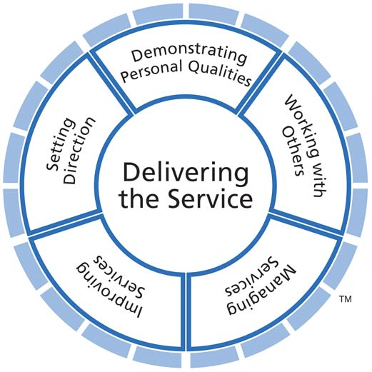
Clinical Leadership
Academy
YOUR general Success Story
Vision
Expectancy
Structure
As a Doctor
As a Career
As a Human
As a progress inspirational, social agent
Notes:
1
1
1
1

Slide 12
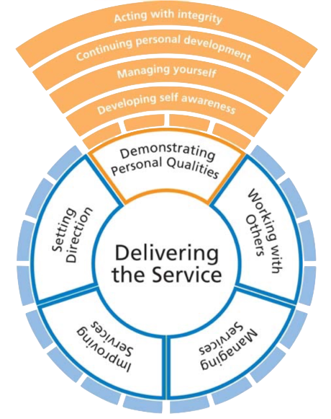
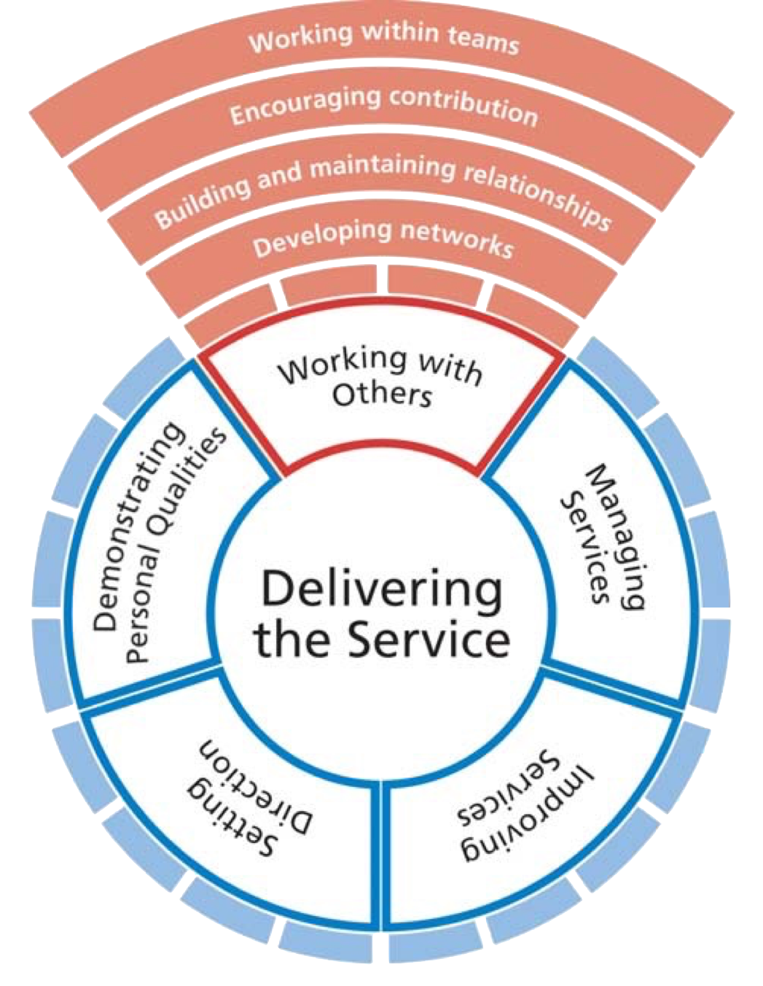
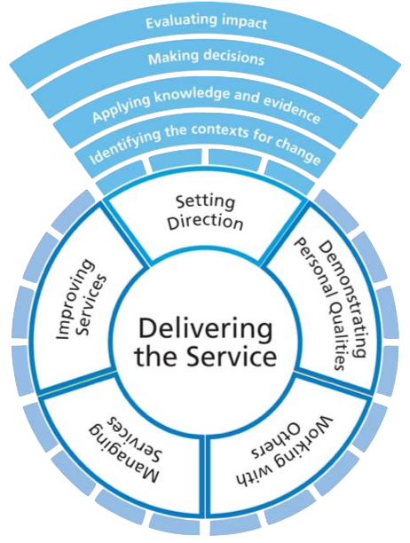
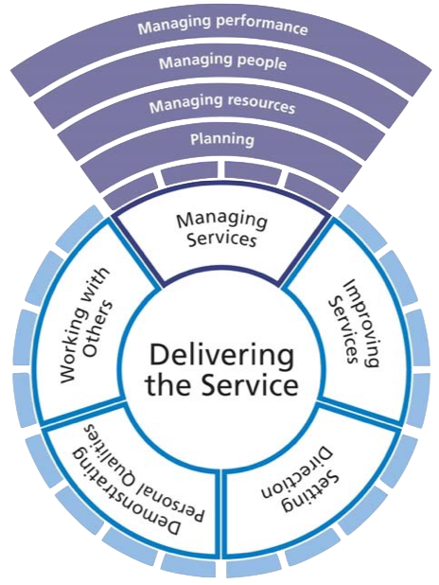
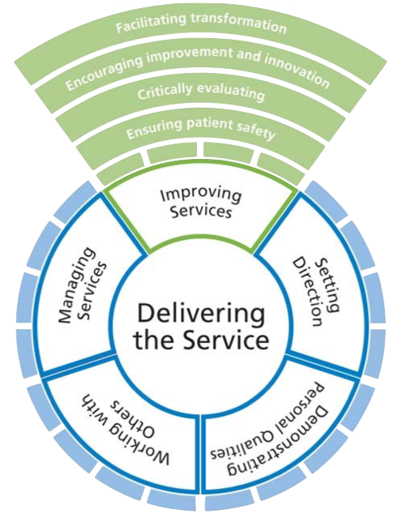
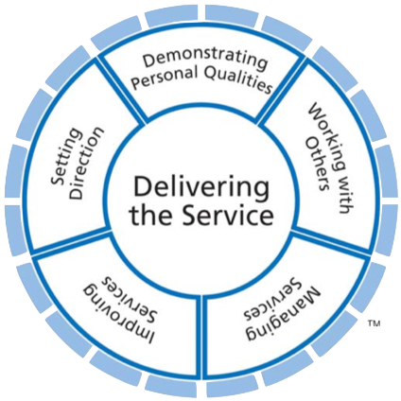
Clinical Leadership
Academy
Vision
Expectancy
Structure
Notes:
1
1
1
1

Slide 13
Clinical Leadership
Academy
Vision
Expectancy
Structure
Relationship with other similar interest organizations
Competency
CPD
Fellows of the European Board of CL
Win
- Win
- Win
Notes:
1
1
1
1

Slide 14
Clinical Leadership
Academy
Vision
Expectancy
Structure
Provides legitimacy
Provides credibility
Bridges gap between organization and clinicians
Brings specialist knowledge
Brings political capital
to the strategic decision-making process
Offers Personal Development
Notes:
1
1
1
1

Slide 15


Clinical Leadership
Academy
Vision
Expectancy
Structure
Personal Development
Notes:
1
1
1
1

